Slide 1
School management system
Presented by:
Name : Amit KUMAR
Roll no : 205120015
subject : dbms LAB
Website link : https://myschool05.herokuapp.com/

Slide 2

outlines
Introduction
Objectives
Er diagram
tables
relations
Technology used

Slide 3
introduction
School Management System is a software which is helpful for school authorities.
School Management System shall be network based Webapp.

Slide 4
objectives
What can Admin do ?
Admin can login.
Admin can add new students, teachers, and modify class details.
Admin can add school notices.
Admin can delete any records.

Slide 5
objectives
What can a Student do ?
Student can login by his class, roll no., and date of birth.
Student can check his/her due fees and their results.
Student can see any new notices of the school.

Slide 6
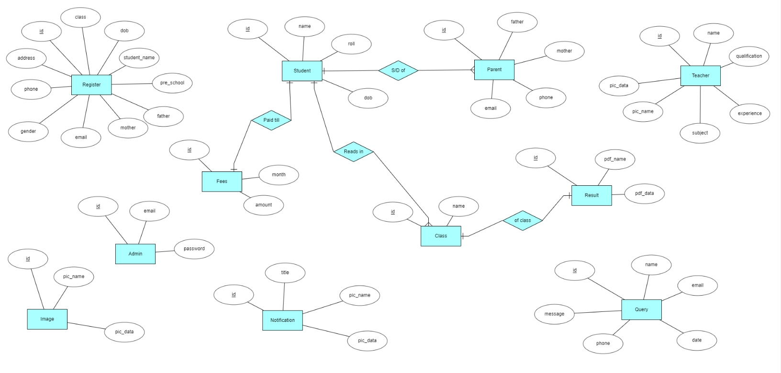
Er diagram

Slide 7
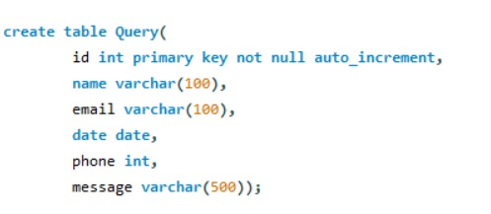
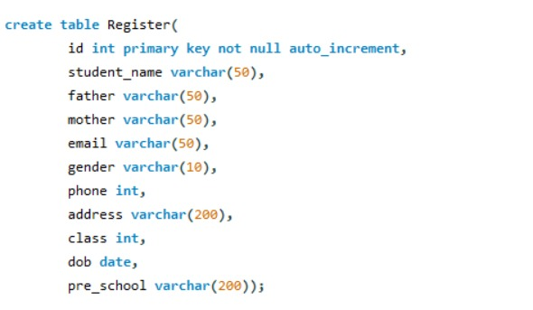
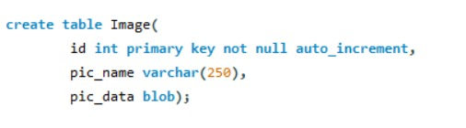
tables

Slide 8
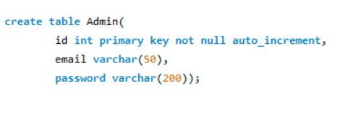
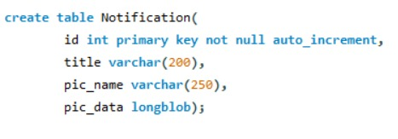
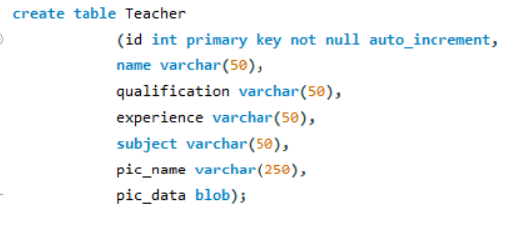
Tables

Slide 9
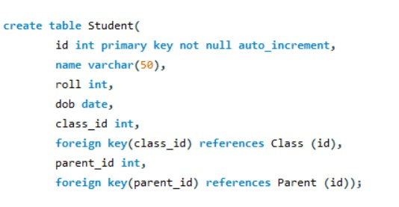
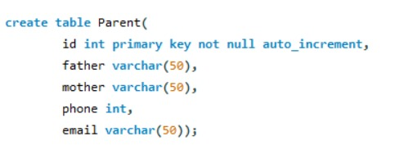
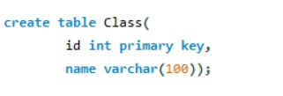
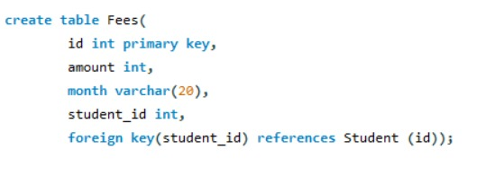
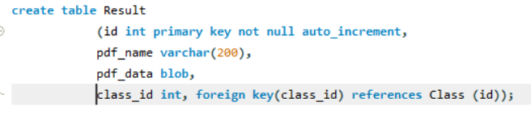
tables

Slide 10
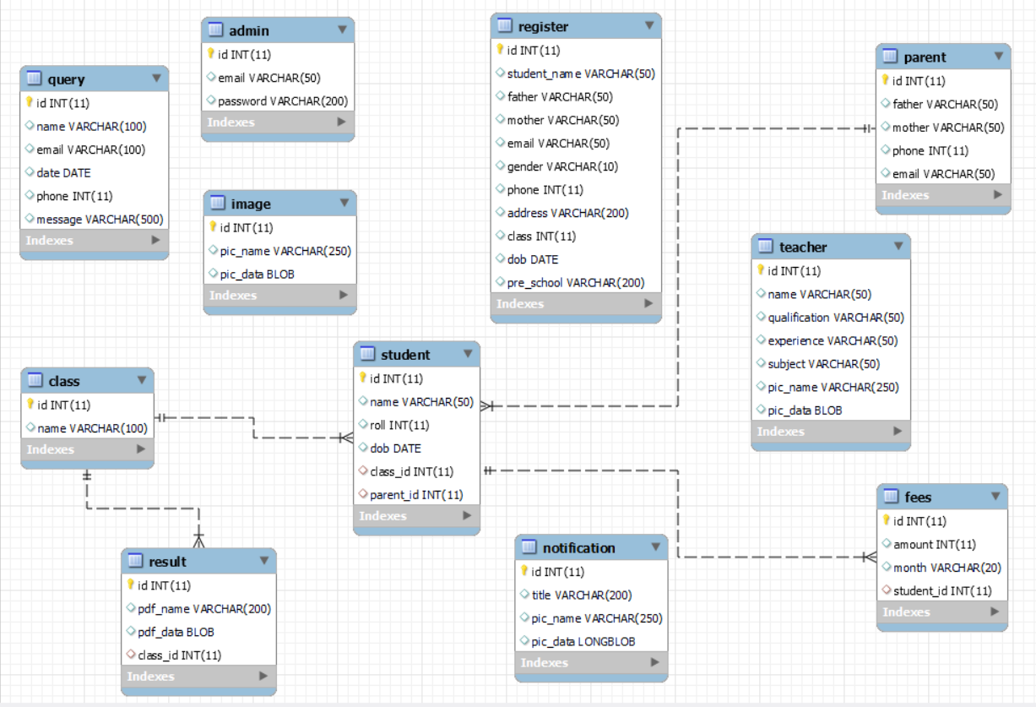
relations

Slide 11
Technology used
TOOL:
VS CODE
FRONTEND :
HTML, CSS, JS, BOOTSTRAP
BACKEND:
PYTHON, FLASK
DATABASE:
MYSQL

